Slide 1
Transonic Compressor

Slide 2
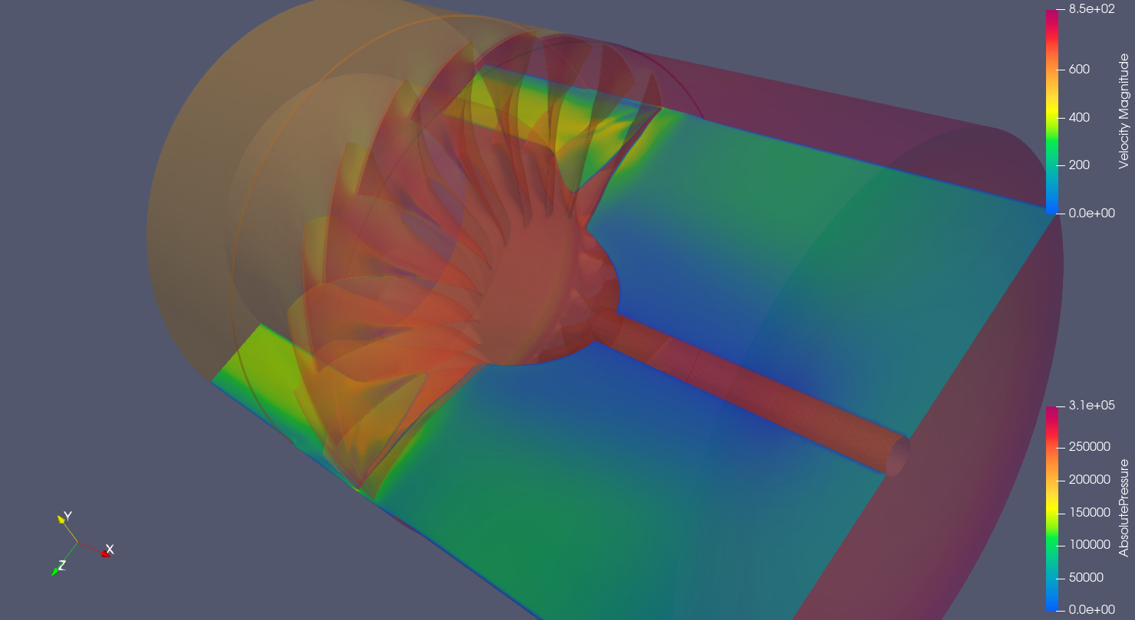
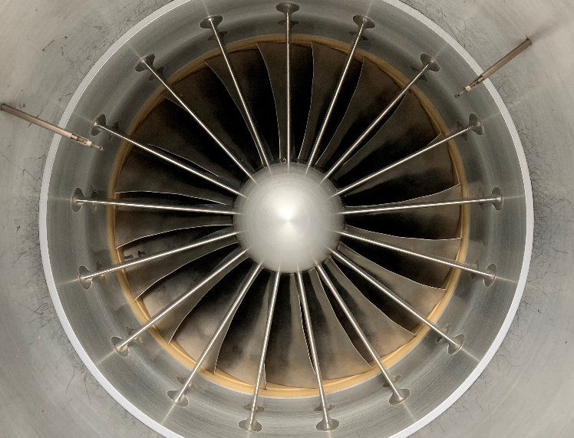
Computational Fluid Dynamics for Axial Compressor Stall Prediction (Funded)
Objectives:
  Validate performance/stall data for Transonic Compressor Rig (TCR)
    Tight Tip Gap
    Large Tip Gap
    1 Casing Treatment
  Determine effect on stall point prediction based on percent of full rotor modelled (single/multiple blade passages -> Full Rotor)
  Perform LES/iDDES simulation for a single configuration (single/multiple blade passages -> Full rotor) to compare stall prediction.
Walter C. Smith, PhD / walter.smith@nps.edu / 831.656.2593

Slide 3
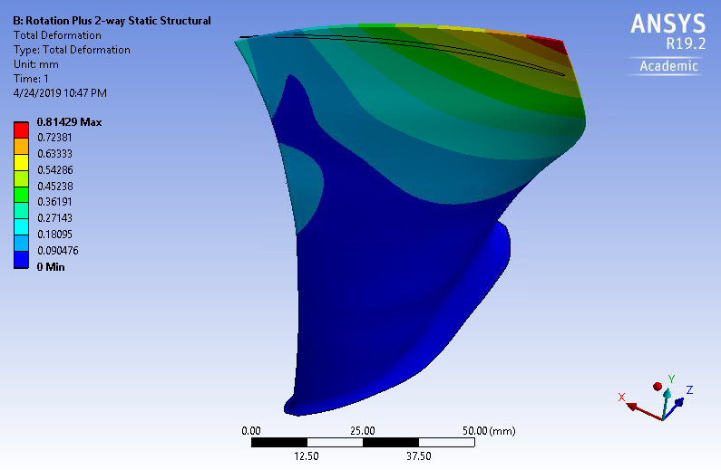
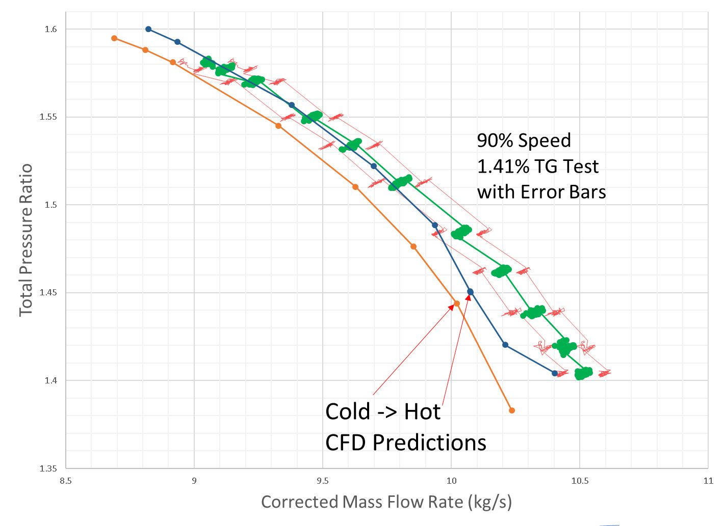
Rotor / casing treatment Computational Fluid Dynamics V&V Study
Model Fluid Structure interactions of Transonic Rotor
Include casing treatment analysis sensitivity study
Potential overlap with stall prediction effort
Walter C. Smith, PhD / walter.smith@nps.edu / 831.656.2593

Slide 4
Automated design of casing treatments
Use Solidworks to generate different casing slot/grooves to increase stall margin in gas turbines for ships and aircraft.
Use simulation to find best one and test this on a real compressor.
Hah, ASME GT2018-75040
Walter C. Smith, PhD / walter.smith@nps.edu / 831.656.2593

Slide 5
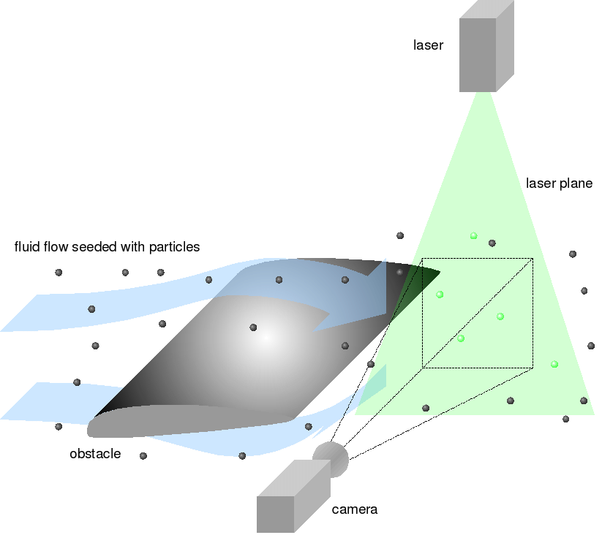
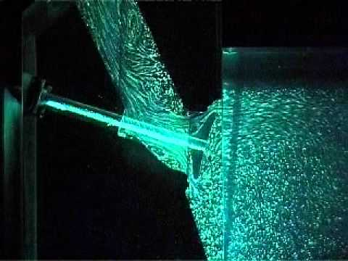
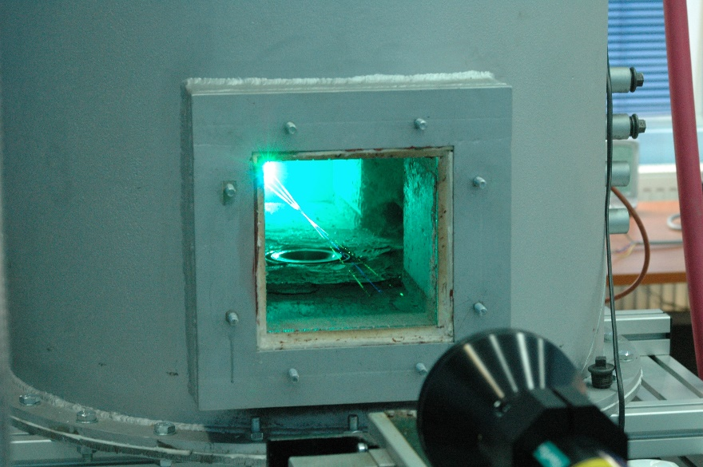
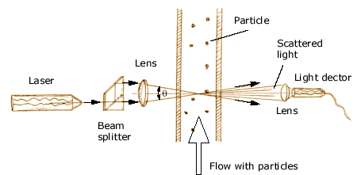
Optical Measurements in TCR/Cascade
Objectives:
  Design waveguide fixturing
  Implement PIV / LDV system in Linear Cascade
  Develop methodology for implementation in TCR
Hurdles
  Laser Safety timelines
Walter C. Smith, PhD / walter.smith@nps.edu / 831.656.2593

Slide 6
Develop New Downstream Transonic Instrumentation / Implement Upstream Probes
Design new downstream instrumentation rakes for
  Pressure
  Kulite (High Speed Pressure)
  Temperature
Use additive manufacturing techniques to facilitate previously impractical designs
Baseline measurements in free-jet
Install and measure in transonic compressor
Data analysis and numerical integration (Baseline and Casing Treatment)
Walter C. Smith, PhD / walter.smith@nps.edu / 831.656.2593

Slide 7
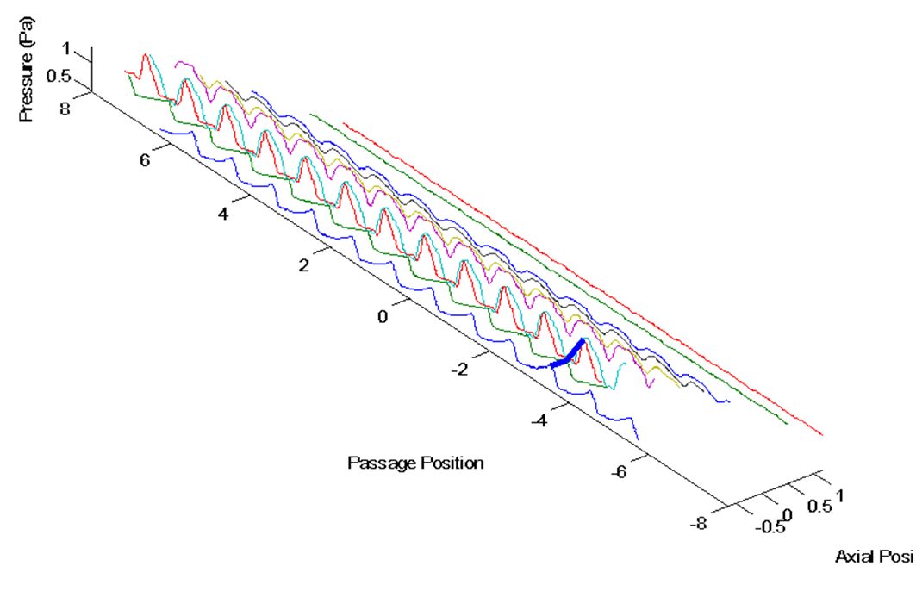
Casing High Speed
Pressure Measurements
Re-implement high speed casing pressure measurements on the NPS Military Fan
Make measurements of shock structure with/without Casing treatments
Walter C. Smith, PhD / walter.smith@nps.edu / 831.656.2593

Slide 8
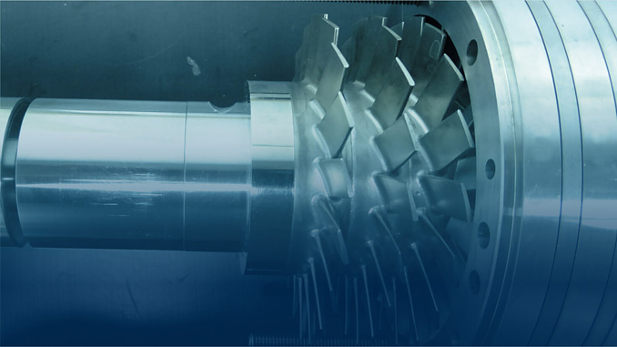
Automated design of multistage compressors (Funded)
Process gas compressor are required and can be powered by new high speed electric motors.
Show video of geometry being generated
https://nps01-my.sharepoint.com/:v:/g/personal/ajgannon_nps_edu/EQ3HQuCW8OBCmmY2yXLiSckBwnbMIU8GOSFNFkejsSRpYQ?e=ACH6ZS
Walter C. Smith, PhD / walter.smith@nps.edu / 831.656.2593

Slide 9
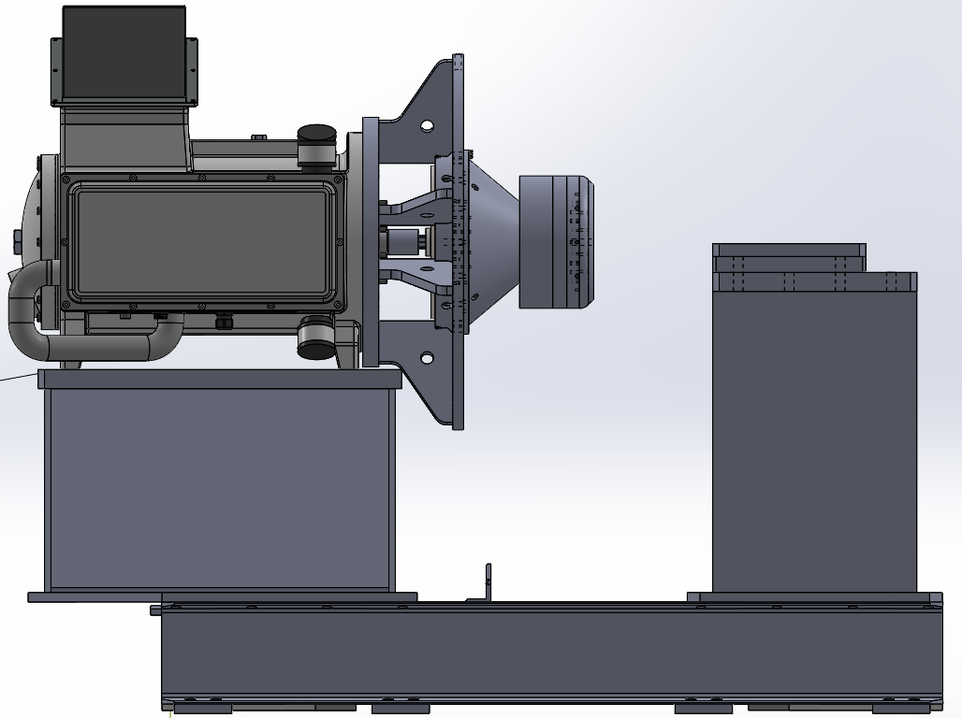
Design of TCR2
Setup and control of New 21000 rpm electric motor
Modification of current Rotor
  Structural/vibration analysis
Design of Casing and flow path
Operational checkout of available parts
Challenging design with many constraints.
Walter C. Smith, PhD / walter.smith@nps.edu / 831.656.2593

Slide 10
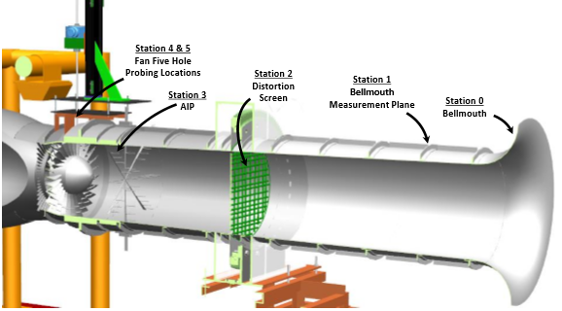
CFD/ Design of Transonic Compressor Inlet Distortion Screen
Development of Inlet Distortion Screen to increase Tip Sensitivity of NPS Military Fan
Computational Simulation and Analysis of Screen
Manufacture an Installation
Measurement of performance in baseline configuration
Measurement of performance with casing treatment to recover stall margin
Image Source: Bailey, Justin Mark. "Full Scale Experimental Transonic Fan Interaction with a Boundary Layer Ingesting Total Pressure Distortion." PhD diss., Virginia Tech, 2017.
Walter C. Smith, PhD / walter.smith@nps.edu / 831.656.2593

Slide 11
Energy Resilience

Slide 12

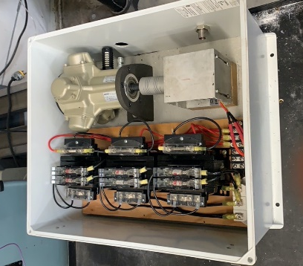
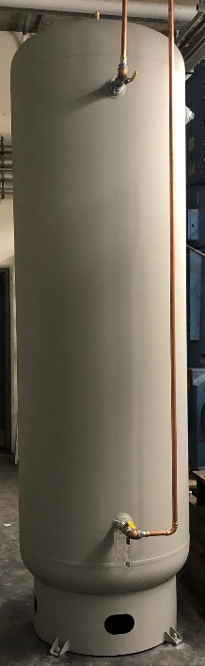
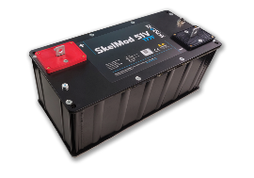
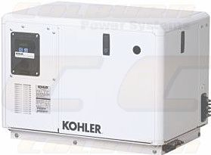

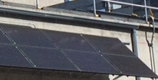
Compressed Air Energy Storage
Multiple Energy Inputs
Supercap microgrid
Graphene
Super-capacitor
Compact
Air Generators
Compressor
DC Generator
Inverter
4 kW
Other air devices.
The thesis will involve coordinating the charging of the compressor and running of the air turbine to deliver power through the microgrid. (All the components are already in place)
Solar
60 Hz Electrical devices.
Notes:
In this slide give the big picture of the compelling technical objectives that will make this project successful.

Slide 13
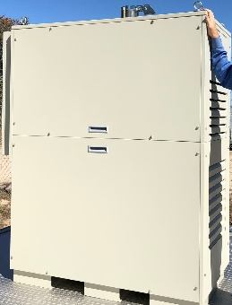
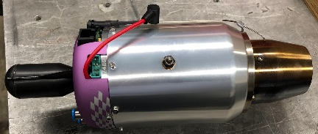
H₂ Gas Turbine Operation
Small Thrust Applications: Modify a small remote control Gas Turbine Engine to run on
30 kW Generator
Thesis topic: A large gas turbine has been modified to run on hydrogen from propane. A switching system to easily change from hydrogen to propane needs to included into the system. With the experience gained from changing the large generator to run on hydrogen (already done) a small thrust producing gas turbine is to be modified to run on hydrogen. Simulations of this have been done to see where high temperatures are and the burner tubes need to be changed to remove these.
Video. https://nps01-my.sharepoint.com/:v:/g/personal/csclay_nps_edu/EWdJJP5vwddDhVuDcnI29K4BZZY-PRNVE033djj_zrBJQQ?e=YkSdY3
Notes:
The hydrogen fuel supply system emphasized safety, as hydrogen can quickly build to flammable concentrations. A regulator brought the tank pressure down to 350-380 kPa, the specified inlet pressure of the high-pressure C30. Stainless-steel tubing was selected for its relative impermeability to H₂. H₂ is a small molecule and diffuses into and embrittles many materials. This is one of several challenges for long-term operation with H₂. The first solenoid valve opens or closes the flow of H₂ and can be remotely controlled. The flame arrestor comprises a heat sink and overpressure relief valve to prevent flashback in a fuel line should it occur. The second solenoid valve leads either to the C30 or vents to the atmosphere. It can also be remotely controlled for the purge process. The H₂ then enters the C30 at the fuel inlet.

Slide 14

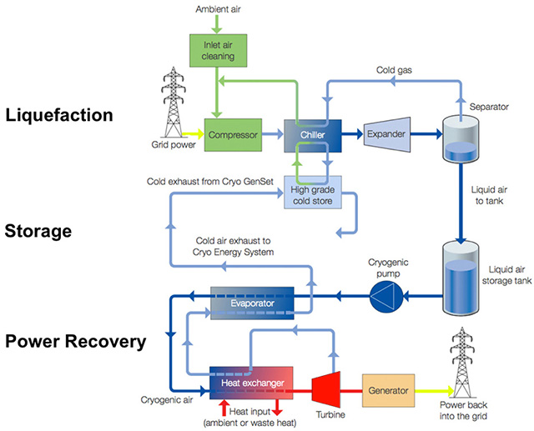
Reengineering & Integrating a Building-Scale Liquid Air Energy Storage (LAES) System
Dr. Anthony Pollman and Dr. Anthony Gannon
Problem Statement
Naval facilities require technologies to mitigate intermittency in distributed (renewable) energy systems to enable operational resilience. Building-scale liquid air energy storage (LAES) can potentially reduce intermittency, however, recent technology demonstrations have failed. Greater understanding is needed to successfully construct, integrate & test a Building-scale LAES demonstration to further assess potential for Naval applications.
Objectives
Use classic analysis to build LAES understanding and inform modeling & simulation efforts.
Use validated model to simulate operations and inform design.
Successful construct and operate a building-scale LAES.
Thesis topics
Integrate a new compact heat exchanger into a cryogenic cooling loop to produce liquid nitrogen. Most of the components have been purchased and are at the school.
Develop a small generator based on Thermoelectric Generators (TEG’s) which are chips that deliver power if cooled on one side and heated on the other. Initially commercially produced liquid nitrogen or dry ice will be used to run the generator.
Notes:
You do not need to talk to this slide.

Slide 15
Misc.

Slide 16
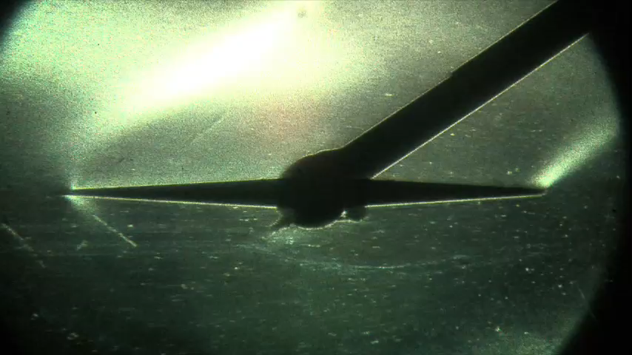
Supersonic wind tunnel upgrade – Mach 4+
Calculate new throat shape
Computational Fluid Dynamics Analysis
Design hardware
Have hardware built
Test in wind tunnel
Walter C. Smith, PhD / walter.smith@nps.edu / 831.656.2593

Slide 17
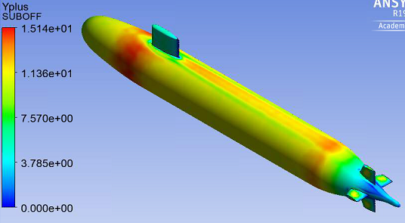
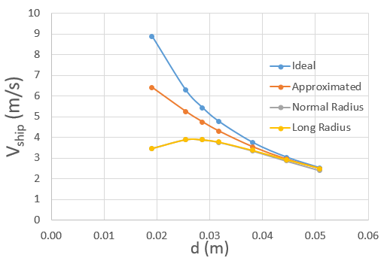
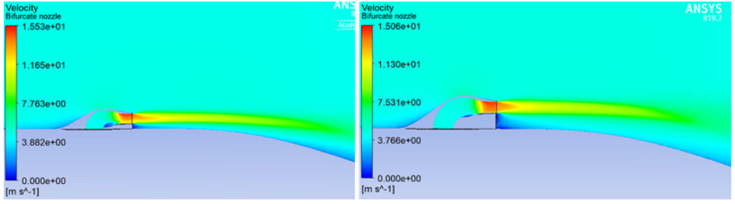
CFD Validation Experiment for Novel Auxiliary Propulsion System
Walter C. Smith, PhD / walter.smith@nps.edu / 831.656.2593

Slide 18
Initial Steam Turbine Test Rig (Foundation)
Design and specification of small scale turbine test rig
Air rather than steam will be used as the working fluid to test early stage concepts
An existing electric drive motor is available which can be run in reverse as a generator to load the turbine
Do basic scaling analysis and come up with equivalent size rig.
Walter C. Smith, PhD / walter.smith@nps.edu / 831.656.2593

Slide 19
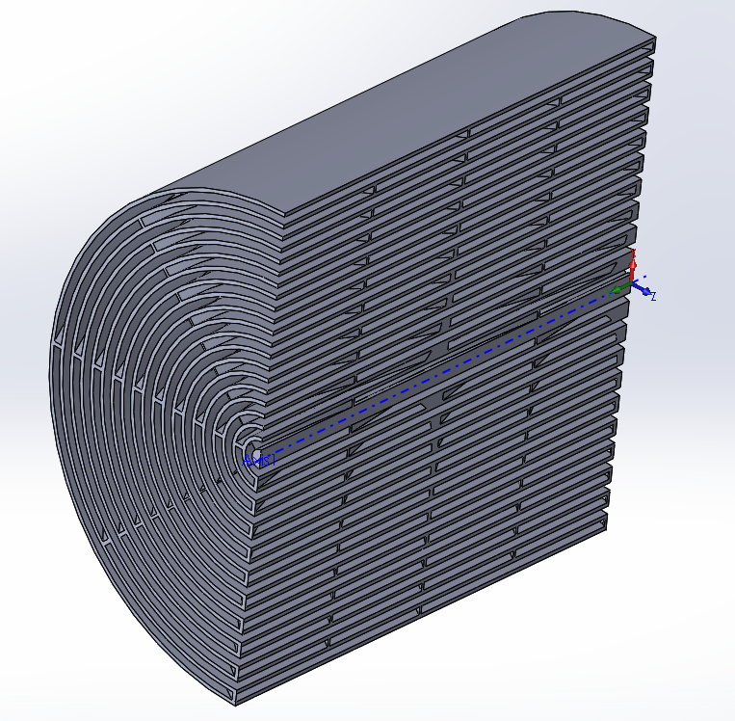
Optimal Low Vibration, low unsteadiness Flow Restriction Geometries (Pseudo-Funded)
Objectives:
  Characterize/Model flow “classical” flow restrictor geometries for hydraulic performance, turbulence, flow instability
  Model flow through AM enabled geometries to find performance (flow instability, turbulence, performace) benefits
  Re-purpose previously developed optimization scheme for use in automated design and analysis of candidate geometries.
  Develop test platform, AM build reference and candidate geometries, test.
Potential Collaborators:
  Naval Surface Warfare Center – Philadelphia Division (NSWCPD)
  Naval Reactors (NAVSEA 08E)
Walter C. Smith, PhD / walter.smith@nps.edu / 831.656.2593

Slide 20
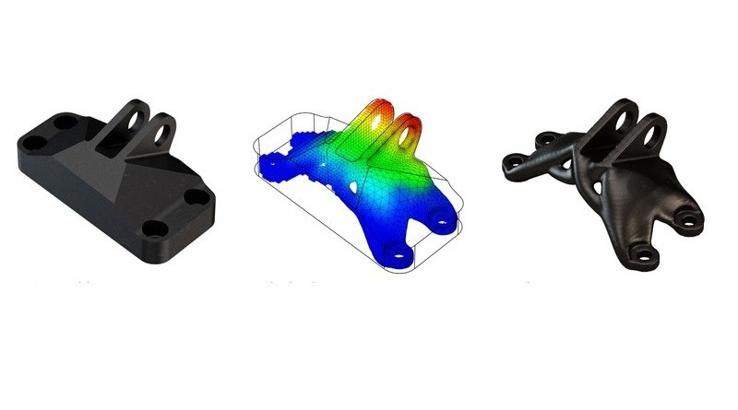
Novel Concepts for Additive Manufacturing (Un-Funded)
Topics
  Valves
  Floating devices
  Topology optimization
  Pressure boundaries
  Design parts
  Build parts
  Test parts
Walter C. Smith, PhD / walter.smith@nps.edu / 831.656.2593

Slide 21
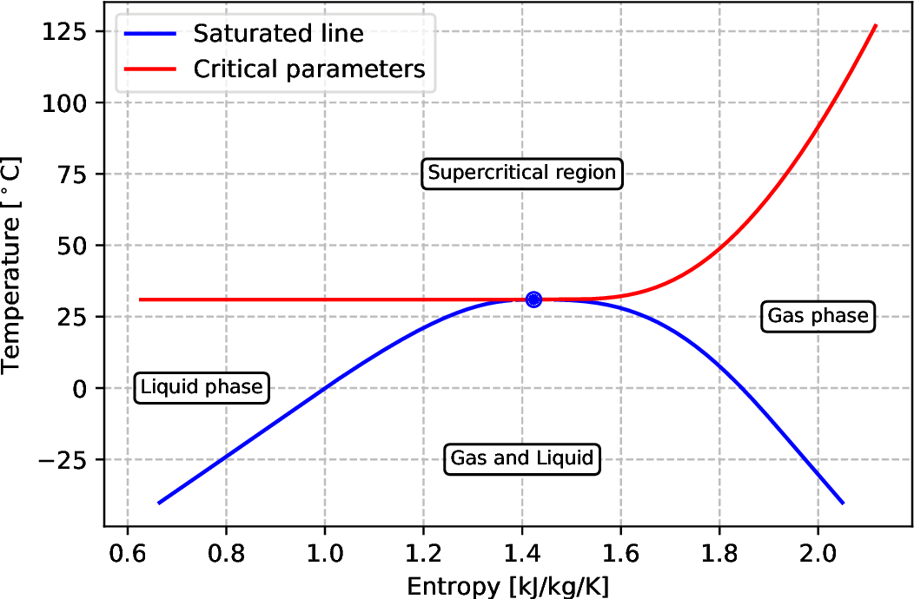
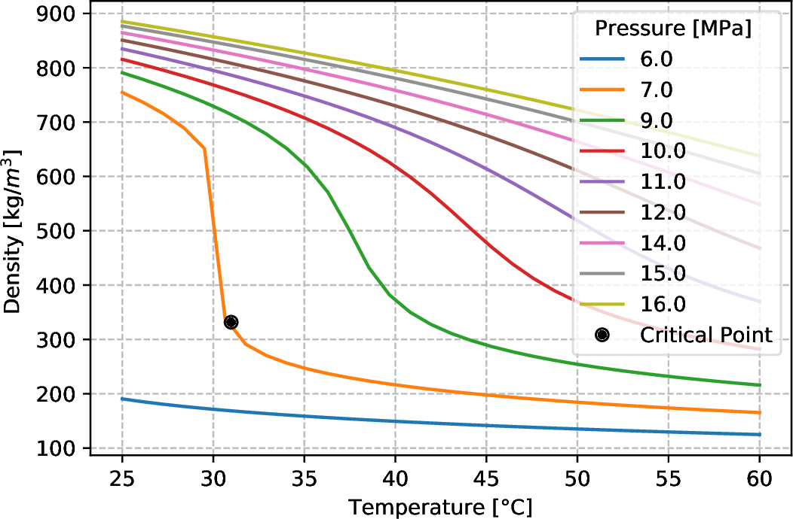
Analysis of Supercritical Pressure Fluid Use for Power Generation (Pseudo-Funded)
Objectives:
  Develop model of HX system for Waste Heat Recovery System
  Validate Numerical analysis for air as working fluid vs. measurement
  Implement appropriate SCO2 properties into Solver (CFX)
  Assess Heat transfer and system stability with SCO2 as working fluid
  Model buoyancy driven system to determine system stability boundary.
Walter C. Smith, PhD / walter.smith@nps.edu / 831.656.2593

Slide 22
Working Slide
Transonic compressor (rotating equp)
McFarland works
ESTEP (h2 and waste heat)
AM
SSWT

Slide 23
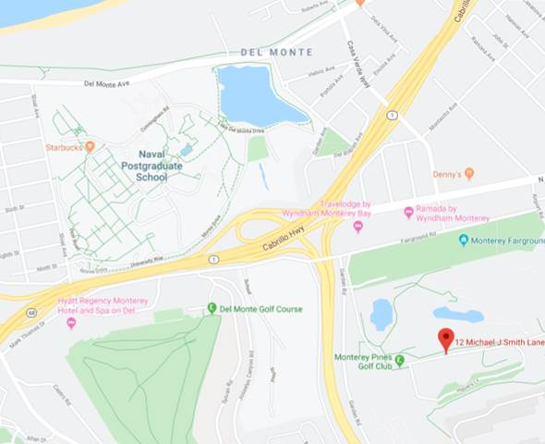
Large Experimental Annex
Located off campus
Other Faculty at the LEA/TPL:
Prof. Hobson
Prof. Gannon
Walter C. Smith, PhD / walter.smith@nps.edu / 831.656.2593

